Slide 1



上海隆程国际
LEAD TRANS
选择LEAD TRANS
智慧储运，把大仓库放进您的小口袋

Slide 2
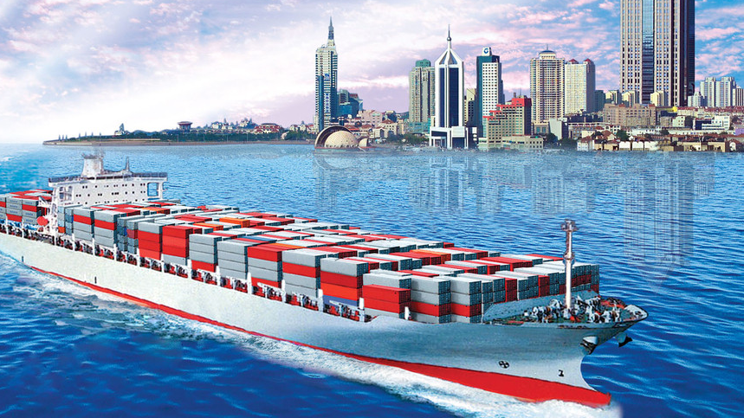

关于我们
About LEAD TRANS
LEAD TRANS 智慧储运
2008年成立于上海，立足本土，全力提供全程国际货运代理服务。
专注进口订舱、进口清关、仓储配送等一站式服务
遍布世界各主要港口和机场的近200家长期物流合作伙伴
专业团队，依据不同产品进口需求整合优质物流资源
高品质的仓储服务，精准“照顾”每一件货物
融合互联网技术，自行开发“Online Warehouse”系统
智能系统让成本更加可预测，同时关注客户货物特性，提供“合身”全程物流方案
上海隆程国际

Slide 3

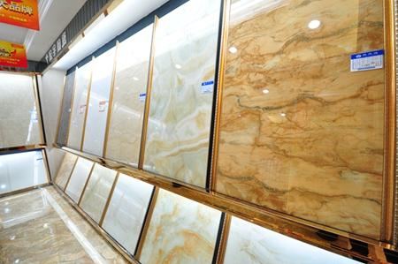
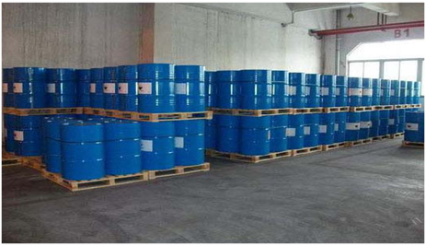

进口业务范围
Scope of import business
保税区内、区外一般贸易进口货物
暂时进口货物
退运货物
返修货物
小型展会货物
木地板
瓷砖建材
危险品
食品类
上海隆程国际

Slide 4





海运进口服务
Ocean Service
隆程与主流航运公司签有长期价格合约，我们以最有竞争力的价格和仓位组合，获得了当地客户的广泛好评
上海隆程国际

Slide 5

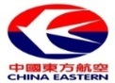

















空运进口服务
Air Service
在中国的主要空港，我们可以提供欧洲、美国、加拿大的灵活物流支持！
上海
北京
深圳
香港
上海隆程国际

Slide 6


强大的代理网络
Worldwide network
GREENLAND
ICELAND
UK
RUSSIA
CANADA
GERMANY
FRANCE
SPAIN
ITALY
JAPAN
U.S.A
CHINA
KOREA
隆程国际依托遍布世界各主要港口和机场近200家长期物流合作伙伴，为您提供专业、快速的订舱、提货、报关的全程紧密目的港服务
TPE
MEXICO
BRAZIL
AFRICA
THAILAND
SINGAPORE
PKL
BRAZIL
AGOENTINA
AUSTRALIA
SOUTH AFRICA
上海隆程国际

Slide 7
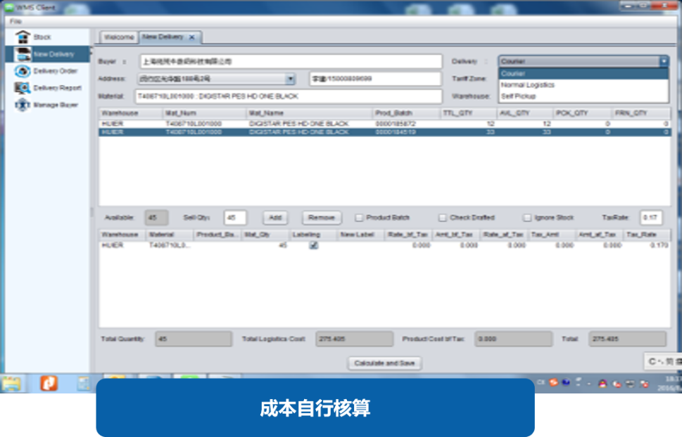
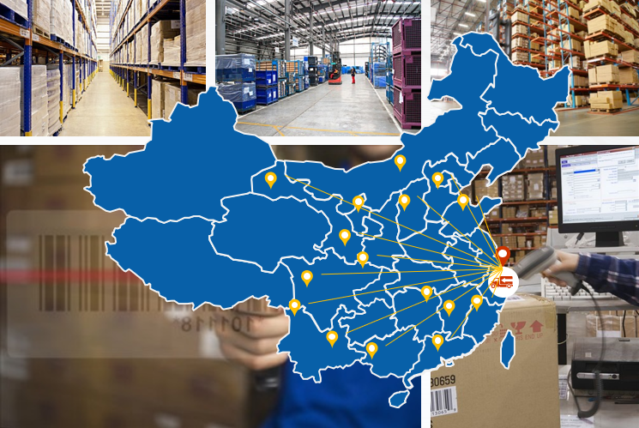
一流团队
First-class team
Online warehousing and distribution
With the integration of Internet technology, we provide you with online cargo data reports anytime and anywhere, just like the warehouse.The data of the goods is refined to the purchase, sale and stock of each batch, which is convenient for your business decision and cost control.
Logistics distribution
Our own fleet of Shanghai Baocheng collection, can highly cooperate with the customs clearance, inspection and other operation progress, to ensure that the first time to arrange the delivery to the door, to complete the strict delivery task.
Based on the foundation of international logistics, we have a deeper understanding of fast service. The agreement warehouse covers Shenzhen/Shanghai/Qingdao/Tianjin/Xiamen port to fully support your global product procurement.
上海隆程国际

Slide 8
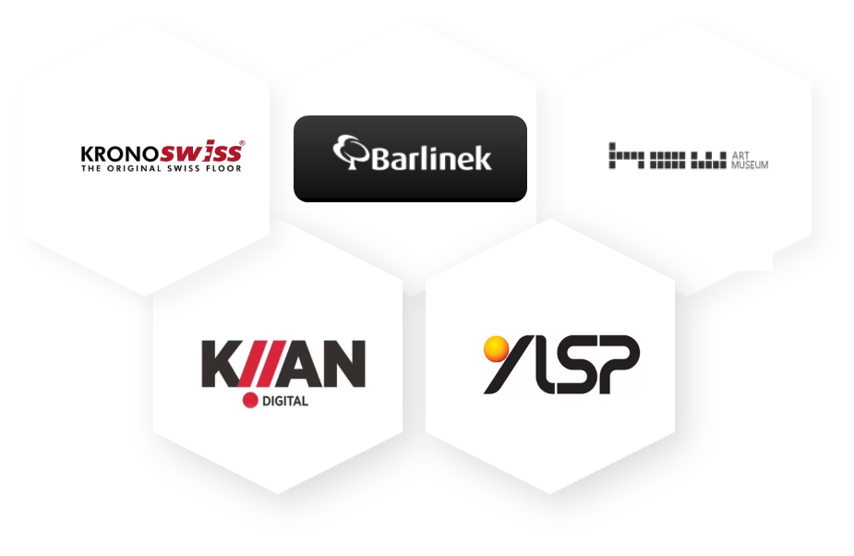
合作企业
Cooperative enterprise
获得知名企业的信赖，我们倍感荣幸
We feel honored to be trusted by well-known enterprises.
上海隆程国际

Slide 9

隆程国际物流对国家报检政策有更深入理解，拥有为客户提供最佳服务的坚实基础
我们依托与船公司的优势资源，提供优先换单服务，快速便捷精简货物进口流程
上海港进口清关，我们与船舶代理深入合作可保证快速完成换单、交单服务。资料齐全的情况下一般到港后1-2天送货。

Slide 10

货物类型及清关特性
Cargo type and customs clearance
Food category
Product name: Banana ，HS CODE 08039000
Clearance time limit ：2-3 days, but delivery upon arrival (excluding inspection, delivery, documents need to be provided one week in advance)
Additional documents are required outside the country ：Motility test certificate, certificate of origin
Additional documents are required in China ： Verification slip (the company to the commodity inspection bureau record quantity, can be greater than the imported quantity)
Peculiarity ：① refrigerator
② Customs clearance should be fast (seasonally limited market competition)
③ Issue the commodity inspection certificate
上海隆程国际

Slide 11

货物类型及清关特性
Cargo type and customs clearance
二、服装成衣及面料类
1.品名：单纱/棉纱(HS:5205/5206/5207)
特质：入库居多，仓储占面积较大，卸货时间慢。
2、品名：服装(女/男士上衣，外套，裤子等/婴儿服装)(61章/62章)
特质：境外服装标签基本不合规，需动检查验时重新贴标(法检货/需出具检验证书居多)
3、品名：运动鞋靴(专业/非专业)(HS:6403皮革鞋面 / 6404纺织鞋面)
特质：由于专业鞋靴关税较高24%，一般都会境外办理协定税率产地证
上海隆程国际

Slide 12
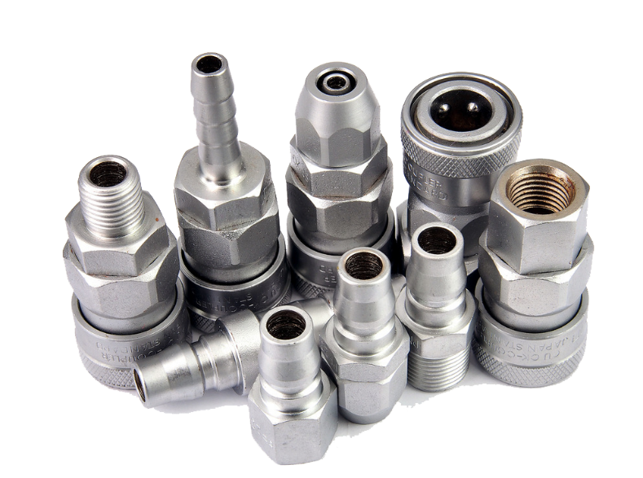
货物类型及清关特性
Cargo type and customs clearance
Ironware
1、 Product name: Pipe (Aluminum pipe, steel pipe, etc.)(Chapter 73 /76)
Documents are required outside the country ：Quality inspection report (generally provided by foreign factories)
Peculiarity ：① Quality inspection report (generally provided by foreign factories)Such goods are liable to be diverted and the accuracy of the domestic destination needs to be ensured
② If you need to issue a commodity inspection certificate, you will cut the pipe for inspection, and foreign countries can do more "one section" for inspection
2、 Name: Screws/metal fasteners, etc.
Peculiarity ： Some tariff codes of steel screws involve anti-dumping, for example: 7318159001. Some tariff codes of steel washers also involve anti-dumping
Such as ： 7318220001(EU countries of origin: anti-dumping needs to provide certificate of origin and the original manufacturer's invoice) Due to the small parts, the customs requires full inspection. Packing list, etc. need to be clear
上海隆程国际

Slide 13
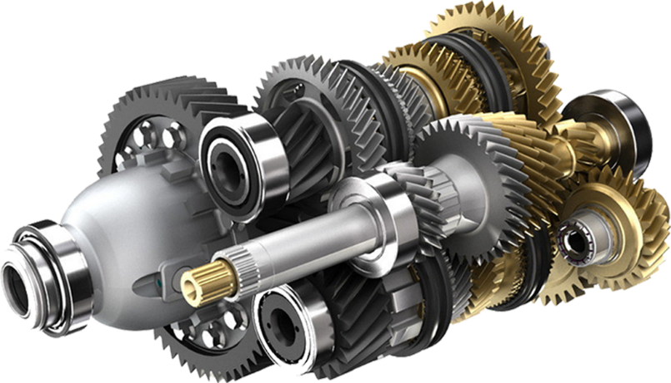
货物类型及清关特性
Cargo type and customs clearance
Enginery
1、 Product Name: Motor/generator (HS: 8501)
Peculiarity ： Electric motors involve 3C and energy efficiency (can be handled in advance. Energy efficiency takes 3-5 days)
2、 Product name: Various machines (industrial machines, kitchen machines, etc.)
Peculiarity ：①All machines need to note the model number. Part about energy efficiency, 3C(Note: The machine is generally within the range of energy efficiency products, such as: refrigerators, air conditioners. 3C Note that strong C may be involved, depending on the tax code)(Energy efficiency can be agent, strong C needs to be handled in Beijing)
②Machines containing pressure vessels need to provide: supervision and inspection certificate, inspection report, quality certificate (pressure vessel manufacturer)
上海隆程国际

Slide 14
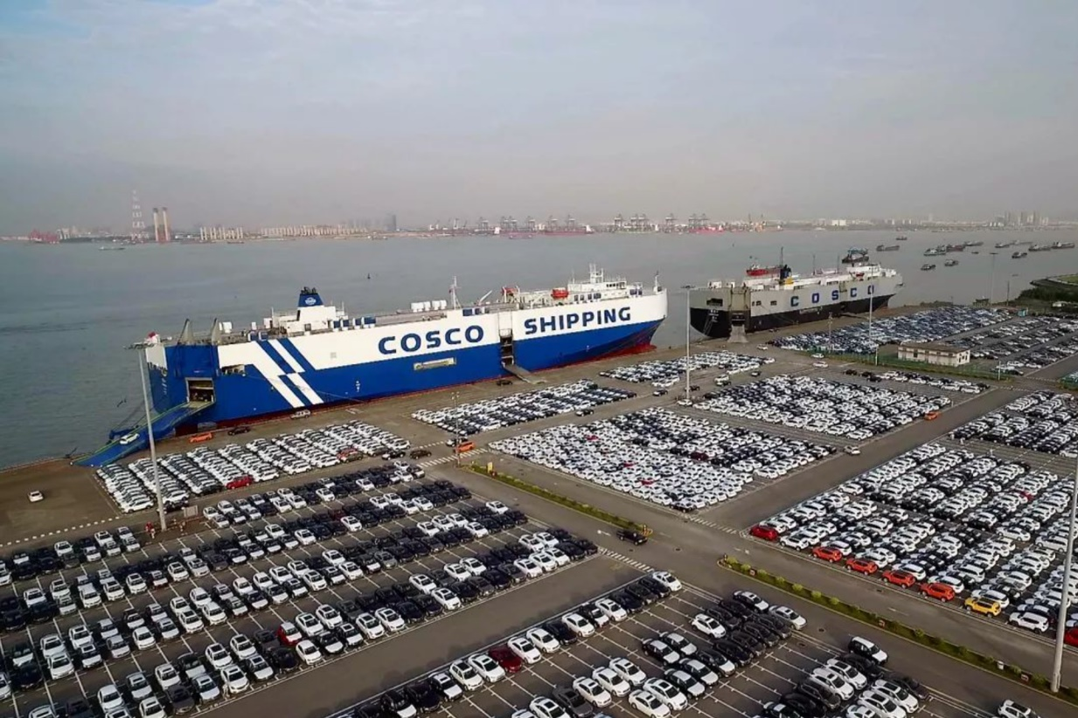
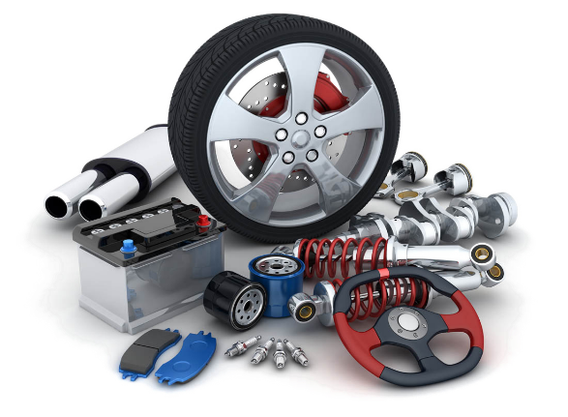
货物类型及清关特性
Cargo type and customs clearance
Auto parts
1、Product name: Auto parts
Peculiarity ：① Product name: Auto partsDeclare the elements to determine whether the plant/auxiliary plant, production/maintenance, etc
②There are many imported goods at one time, so it is necessary to provide accurate packing list
上海隆程国际

Slide 15
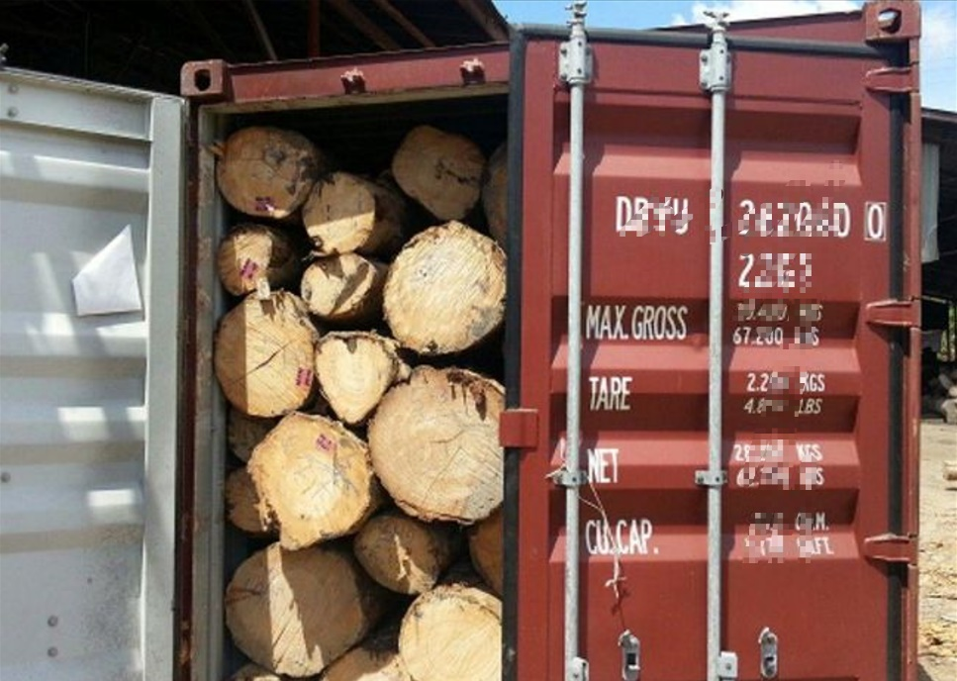
货物类型及清关特性
Cargo type and customs clearance
Wood products
1、 Product Name: Seat (HS: 9401)
Peculiarity ：①The Customs classifies wood frame seats as endangered/non-endangered. Endangered need to apply for Endangered Import Certificate (Forestry Bureau)
②Other seats involve 3C (there is no model on the general goods, but product information is required when 3C is handled, and the corresponding goods need to be specified)
2、 Product name: Wood furniture (HS: 9403)
Peculiarity ：①This to finished furniture, wood veneer installed on the wall this does not belong to furniture, to be classified as wood products
②Furniture needs to provide deep processing certificate (issued by foreign factory)
上海隆程国际

Slide 16
货物类型及清关特性
Cargo type and customs clearance
Wood products
3、 Product Name: Wood flooring (Finished product)
4、 Product name: Logs (non-endangered raw materials, pine, etc.)
Additional documents are required outside the country ：Deep processing certificate (generally issued by overseas factories)
Peculiarity ：①The inspection rate was relatively high (H986)
② If the outsourcing is bundled, most of them have no place of origin (it is recommended that customers abroad do a certificate of origin and then enter the country)
③ Issue commodity inspection certificate (for sales)
Additional documents are required outside the country ：Motility test certificate, certificate of origin
Peculiarity ：① Relatively high inspection rate (H986)
② If the outsourcing is bundled, most of them have no place of origin (customers are advised to do the certificate of origin abroad and enter the country again)
③ Issue commodity inspection certificate (for sales)
④ When doing the inspection, if there is insect infestation, etc., can not be fumigated, it is necessary to return to abroad according to the situation
上海隆程国际

Slide 17
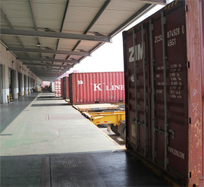
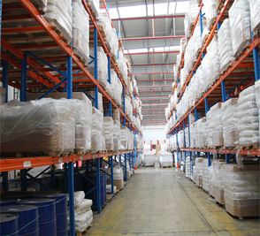
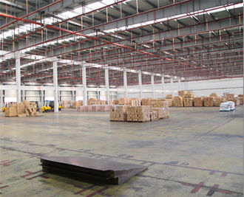
在线仓储配送
Storage and distribution
在线仓储配送--- 专业仓库管理
高效配合，严谨安全
卸货平台
整洁高效
立体仓
精准管理
平面仓
宽敞明亮
隆程物流仓库: 我们不仅为您投入互联网技术，更有专业的管理团队，帮您精准“照顾”每一件货物
隆程仓库增值服务: 我们不仅为您提供货物存储及中转服务，更能按照您的产品特性进行货物再包装及分批发货服务
上海隆程国际

Slide 18
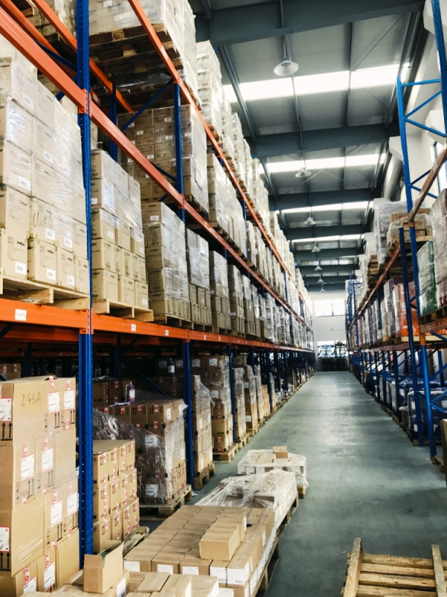
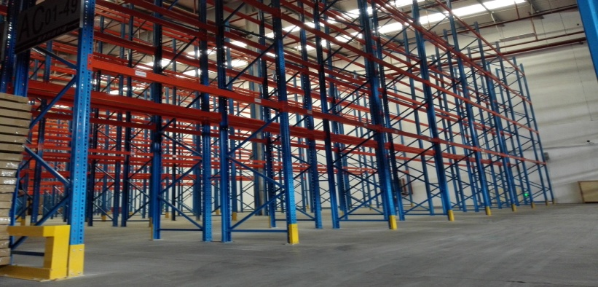
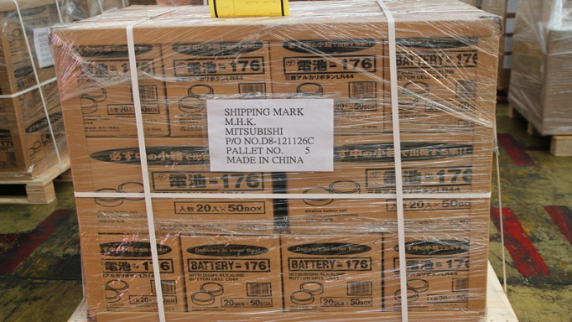
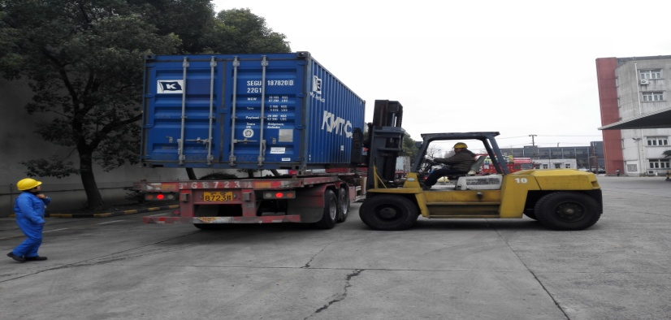
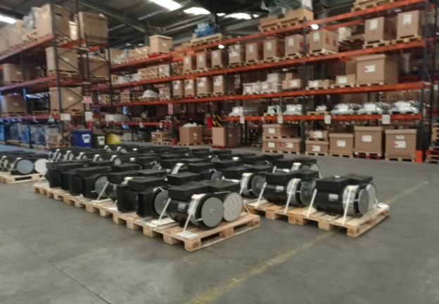
在线仓储配送
Storage and distribution
上海隆程国际

Slide 19
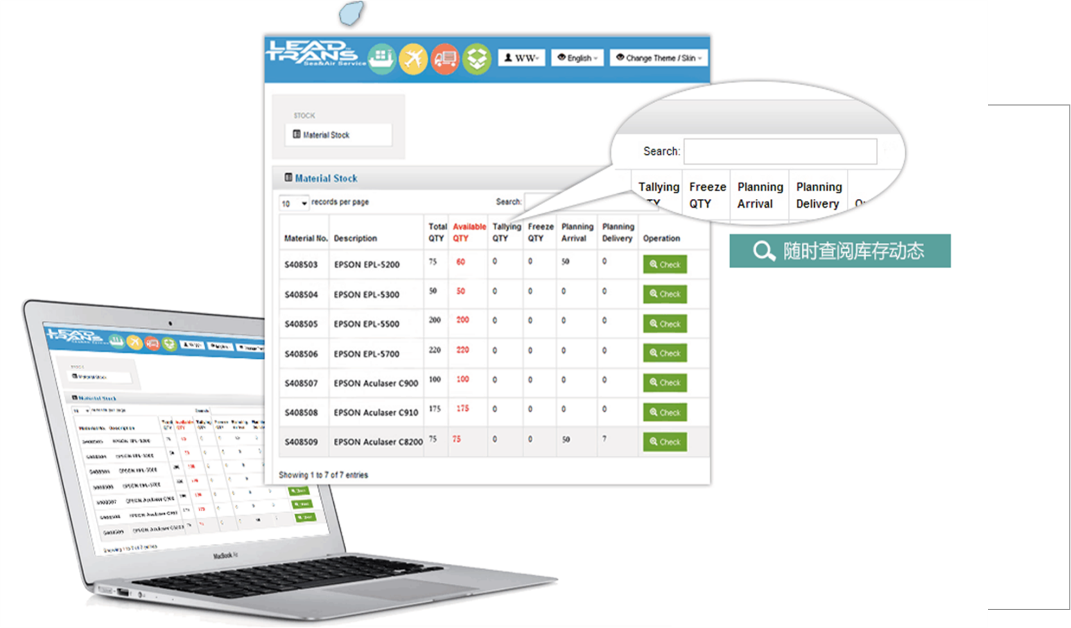
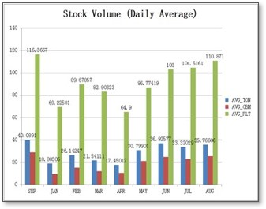
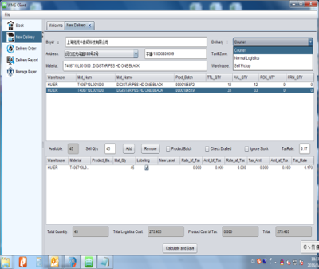
在线仓储系统
Online storage and distribution
在线仓储配送---专注快速服务
随时查阅数据，及时货物配送
隆程在线查询：融合互联网技术，我们为您提供网上随时随地的货物数据报表，如同仓库随身携带。
货物数据细化至每一批次的进销存情况，方便于您的商务决策及成本管控。
自动生成订单
销售报表查询
成本自行核算
上海隆程国际

Slide 20
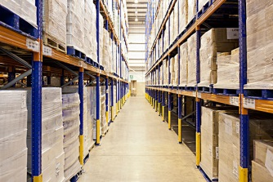
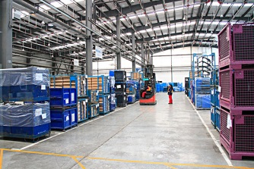
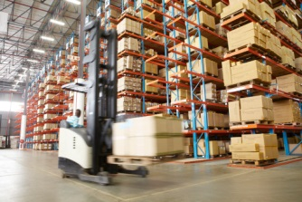


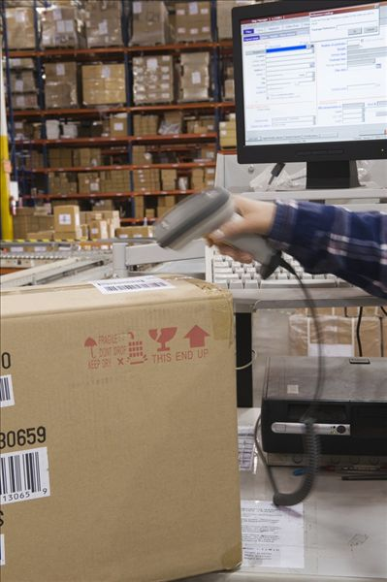
在线仓储配送
Online storage and distribution
在线仓储配送---专注快速服务
随时查阅数据，及时货物配送
隆程物流配送
我司自有车队上海宝程集运，可高度配合海关放关、查验等操作进度，确保第一时间安排送货到门，完成严苛的交货期任务。
依托于国际物流的基础，我们对快速的服务有更深入的认知。协议仓库覆盖深圳/上海/青岛/天津/厦门港口，充分支持您的全球产品采购
——及时快速地将您的商品发往全国

Slide 21

EVERY DETAILS LEAD
US
BETTER
隆程国际
智慧储运 把大仓库放进您的小口袋
上海隆程国际

